Slide 1
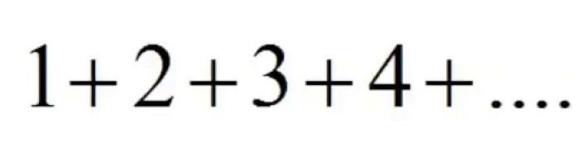

Demystifying
The Infinite Summation of Natural Numbers
Avinash Singh
MTech [Mathematics and Computing]
Indian Institute of Technology Patna

Slide 2
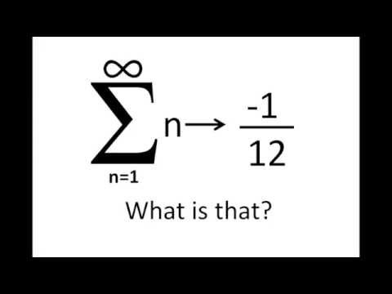
?

Slide 3
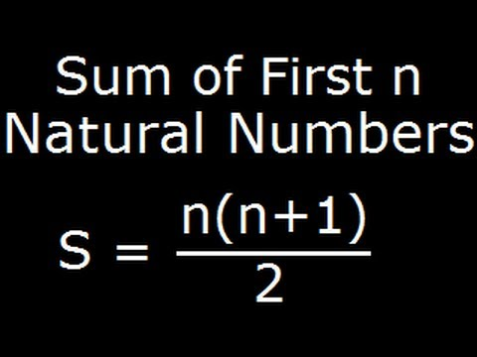
For a simple Arithmetic Progression.
A Sum of natural numbers from 1 to n.
The answer is n(n+1)/2.
Atleast,
this is what we were taught all
throughout our schooling.

Slide 4

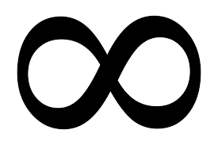
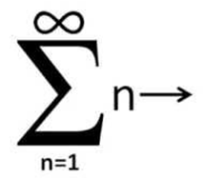
So,
if ‘n’ were to tend to infinity,
summation should tend to infinity

Slide 5

Right

Slide 6


Slide 7
Yes, mathematicians are saying ‘No’.

Slide 8


Confused ?

Slide 9

Is there some hidden mystery behind this?
Let us Find it out!

Slide 10
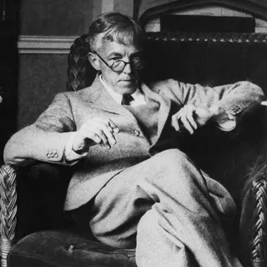
History behind the Summation!
A hundred and Seven years ago, in 1913, the famous British mathematician
G. H. Hardy received a letter out of the blue.
The Indian (British colonial) stamps and curious handwriting
caught his attention, and when he opened it, he was flabbergasted.
Its pages were crammed with equations —
many of which he had never seen before.
There were many kinds of
formulas there, and those that first caught his attention
had to do with
algebraic numbers . Hardy was the leading number
theorist in the world —
how could he not recognize the identities
relating to such numbers,
scribbled on the rough paper? Were these new
derivations, or were they
just nonsensical math scrawls? Later,
Hardy would say this a
bout the formulas: “They defeated me completely.
I had never seen
anything in the least like it before!”

Slide 11
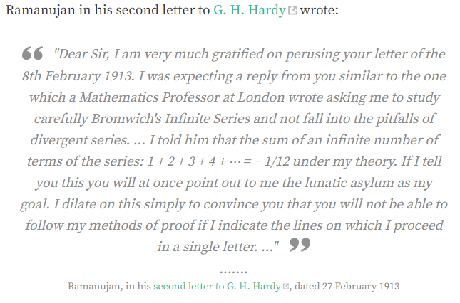

Slide 12
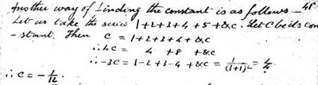
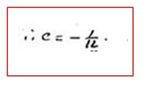


Slide 13
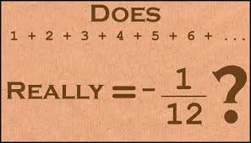

Slide 14
Let S = 1+2+3+4+5+6+7+…

Slide 15
Let S = 1+2+3+4+5+6+7+…
Consider S1= 1-1+1-1+1-1+1-1…

Slide 16
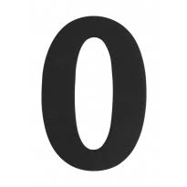
Let S = 1+2+3+4+5+6+7+…
Consider S1= 1-1+1-1+1-1+1-1…

Slide 17
Let S = 1+2+3+4+5+6+7+…
Consider S1= 1-1+1-1+1-1+1-1…

Slide 18
Let S = 1+2+3+4+5+6+7+…
Consider S1= 1-1+1-1+1-1+1-1…

Slide 19
Let S = 1+2+3+4+5+6+7+…
Consider S1= 1-1+1-1+1-1+1-1…

Slide 20

Let S = 1+2+3+4+5+6+7+…
Consider S1= 1-1+1-1+1-1+1-1…

Slide 21
Let S = 1+2+3+4+5+6+7+…
Consider S1= 1-1+1-1+1-1+1-1…

Slide 22
Let S = 1+2+3+4+5+6+7+…
Consider S1= 1-1+1-1+1-1+1-1…

Slide 23
Let S = 1+2+3+4+5+6+7+…
Consider S1= 1-1+1-1+1-1+1-1…

Slide 24
Now, this sum should be 0 or 1 based on number of natural
numbers taken.
If infinite numbers are even, S1=0, if odd S1=1.
But, Riemann zeta function gives it a value of ½.
Mathematical community too agrees that the sum is ½.
How?
serious mathematical work went into the proof.
If you are interested to know, please go
through Ramanujan’s summation principles and zeta function

Slide 25
Having said that , Let us try a simple proof avoiding all the
complexity.
S1=1-1+1-1+1-1+1…

Slide 26
Having said that , Let us try a simple proof avoiding all the
complexity.
S1=1-1+1-1+1-1+1…
1-S1=1-(1-1+1-1+1-1+1…)

Slide 27
Having said that , Let us try a simple proof avoiding all the
complexity.
S1=1-1+1-1+1-1+1…
1-S1=1-(1-1+1-1+1-1+1…)
1-S1=1-1+1-1+1-1+1…..

Slide 28
Having said that , Let us try a simple proof avoiding all the
complexity.
S1=1-1+1-1+1-1+1…
1-S1=1-(1-1+1-1+1-1+1…)
1-S1=
1-1+1-1+1-1+1-1+1-1+…

Slide 29
Having said that , Let us try a simple proof avoiding all the
complexity.
S1=1-1+1-1+1-1+1…
1-S1=1-(1-1+1-1+1-1+1…)
1-S1=
1-1+1-1+1-1+1-1+1-1+…
1-S1 = S1
So, S1 = ½ (I)

Slide 30
Now,
Let S2 = 1-2+3-4+5-6+7…..

Slide 31
Now,
Let S2 = 1-2+3-4+5-6+7…
Adding S2 both sides ,
S2 = 1-2+3-4+5-6+7…
+ S2 1-2+3-4+5-6+7…

Slide 32
Now,
Let S2 = 1-2+3-4+5-6+7…
Adding S2 both sides ,
S2 = 1-2+3-4+5-6+7…
+ S2 1-2+3-4+5-6+7…
2S2 = 1-1+1-1+1-1+1…..

Slide 33
Now,
Let S2 = 1-2+3-4+5-6+7…
Adding S2 both sides ,
S2 = 1-2+3-4+5-6+7…
+ S2 1-2+3-4+5-6+7…
2S2 = 1-1+1-1+1-1+1…
2S2 = S1 From(I)
2S2 = ½
S2 = ¼ (II)

Slide 34
Let’s come back to our sum of infinite numbers.
S=1+2+3+4+5+6+7+8+9…..

Slide 35
Let’s come back to our sum of infinite numbers.
S=1+2+3+4+5+6+7+8+9…..
S2=1-2+3-4+5-6+7-8+9….

Slide 36
Let’s come back to our sum of infinite numbers.
S=1+2+3+4+5+6+7+8+9…..
S2=1-2+3-4+5-6+7-8+9….
S-S2 = 4+8+12+16+20…..

Slide 37
Let’s come back to our sum of infinite numbers.
S=1+2+3+4+5+6+7+8+9…..
S2=1-2+3-4+5-6+7-8+9….
S-S2 = 4+8+12+16+20…..
S-S2 = 4(1+2+3+4+5+6+7+8….)
S-S2 = 4S
-3S = S2
-3S = ¼ (From (II))
S =
-1/12

Slide 38
Amazing!!!
Our sum is negative!

Slide 39
Number-theorists call it
“One of the most remarkable formulae in science”.

Slide 40
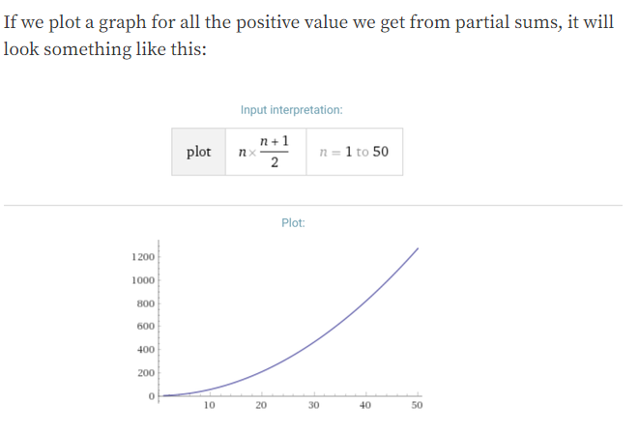
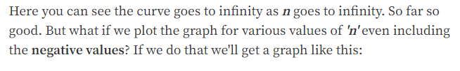

Slide 41
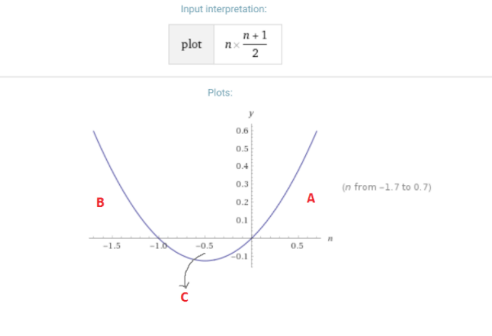

Slide 42
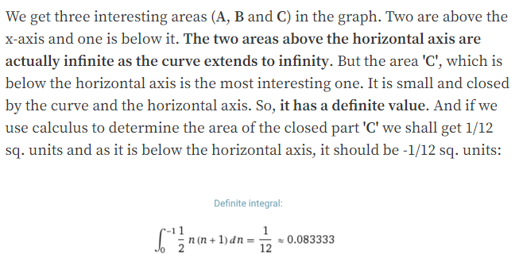

Slide 43
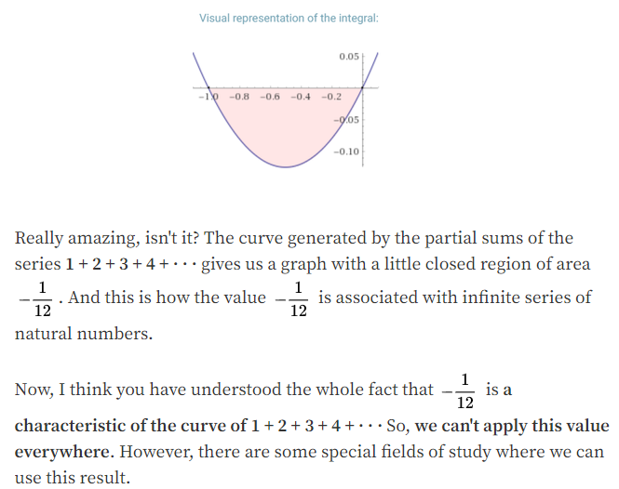

Slide 45
Further, it is interesting to know ‘S’=-1/12 has been used to derive the equations in
“string theory”, quantum field theory and in some complex analytics.

Slide 46
References
When Infinity Is Actually a Small, Negative Fraction - Slate.com
https://blogs.scientificamerican.com/roots-of-unity/does-123-really-equal-112/
Ramanujan's full letter to Hardy

